Slide 1
JNCIS-ENT
Border Gateway Protocol (BGP)

Slide 2
BGP Configuration and Monitoring
6
BGP policy and neighbor configuration and monitoring

Slide 3
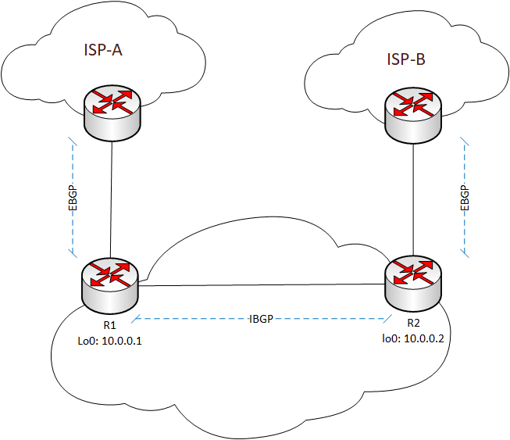
Topology and Configuration Goal
Configure peerings between IBGP loopback addresses
Configure EBGP peerings between interface addresses
Change the next-hop attribute of EBGP-learned routes to the loopback address of the readvertising router
Configure and redistribute an aggregate route into BGP

Slide 4
BGP Configuration
Peer-as command is needed for internal peerings if the peering type is not specified
The local router’s AS may be specified in the BGP hierarchy or routing-options hierarchy
BGP neighbors may be grouped to simplify configuration
[edit]
lab@R1# show protocols bgp
group ISP-A {
type external;
neighbor 197.141.52.1 {
peer-as 16140;
}
}
group Enterprise {
peer-as 64501;
neighbor 10.0.0.2 {
local-address 10.0.0.1;
}
}
[edit]
lab@R1# show routing-options
router-id 10.0.0.1;
autonomous-system 64501;

Slide 5
Next-hop-self Policy
The next-hop-self policy must be applied as an export policy to the IBGP neighbor or group
The accept action must not be used, or it will apply to all routes, not just EBGP-learned routes
[edit]
lab@R1# show protocols bgp
group ISP-A {
type external;
neighbor 197.141.52.1 {
peer-as 16140;
}
}
group Enterprise {
export next-hop-self;
peer-as 64501;
neighbor 10.0.0.2 {
local-address 10.0.0.1;
}
}
[edit]
lab@R1# show policy-options
policy-statement next-hop-self {
term BGP-term {
from {
protocol bgp;
external;
then {
next-hop self;
}
}
}

Slide 6
Aggregate Route Policy
[edit]
lab@vSRX1# show protocols bgp
group ISP-A {
export bgp-aggregate;
type external;
neighbor 197.141.52.1 {
peer-as 16140;
}
}
group Enterprise {
export next-hop-self;
peer-as 64501;
neighbor 10.0.0.2 {
local-address 10.0.0.1;
}
}
[edit]
lab@R1# show routing-options
router-id 10.0.0.1;
autonomous-system 64501;
aggregate {
route 172.16.0.0/21;
}
[edit]
lab@R1# show policy-options
policy-statement bgp-aggregate {
term match-agg {
from {
protocol aggregate;
route-filter 172.16.0.0/21 exact;
}
then accept;
}
}

Slide 7
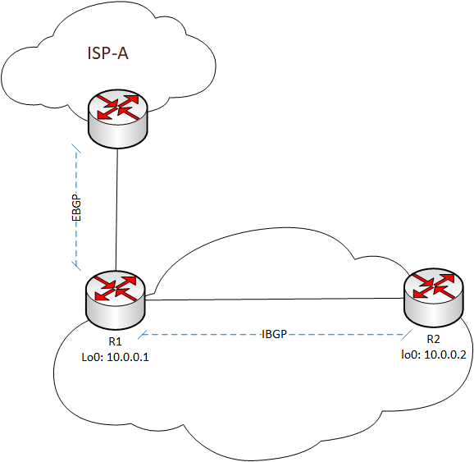
Monitoring BGP
lab@R1> show bgp summary
Groups: 2 Peers: 2 Down peers: 0
Table Tot Paths Act Paths Suppressed History Damp State Pending
inet.0 1 1 0 0 0 0
Peer AS InPkt OutPkt OutQ Flaps Last Up/Dwn State|#Active/Received/Accepted/Damped...
10.0.0.2 65401 30 31 0 0 12:43 0/0/0/0 0/0/0/0
197.141.52.1 16140 17 17 0 0 6:31 1/1/1/0 0/0/0/0
lab@R2> show bgp summary
Groups: 1 Peers: 1 Down peers: 0
Table Tot Paths Act Paths Suppressed History Damp State Pending
inet.0 1 1 0 0 0 0
Peer AS InPkt OutPkt OutQ Flaps Last Up/Dwn State|#Active/Received/Accepted/Damped...
10.0.0.1 65401 28 27 0 1 11:14 1/1/1/0 0/0/0/0

Slide 8
Monitoring BGP Cont.
lab@R1> show bgp neighbor
Peer: 10.0.0.2+179 AS 65401 Local: 10.0.0.1+63058 AS 65401
Type: Internal State: Established Flags: <Sync>
Last State: OpenConfirm Last Event: RecvKeepAlive
Last Error: None
Export: [ next-hop-self ]
Options: <Preference LocalAddress PeerAS Refresh>
Local Address: 10.0.0.1 Holdtime: 90 Preference: 170
Number of flaps: 0
Peer ID: 10.0.0.2 Local ID: 10.0.0.1 Active Holdtime: 90
Keepalive Interval: 30 Peer index: 0
BFD: disabled, down

Slide 9
Monitoring BGP Routes
lab@R1# run show route receive-protocol bgp 197.141.52.1
inet.0: 17 destinations, 17 routes (17 active, 0 holddown, 0 hidden)
Prefix Nexthop MED Lclpref AS path
* 0.0.0.0/0 197.141.52.1 16140 I
lab@R2# run show route receive-protocol bgp 10.0.0.1
inet.0: 17 destinations, 20 routes (17 active, 0 holddown, 0 hidden)
Prefix Nexthop MED Lclpref AS path
* 0.0.0.0/0 10.0.0.1 100 16140 I

Slide 10
Monitoring BGP Routes Cont.
lab@R1> show route advertising-protocol bgp 10.0.0.2
inet.0: 17 destinations, 17 routes (17 active, 0 holddown, 0 hidden)
Prefix Nexthop MED Lclpref AS path
* 0.0.0.0/0 Self 100 16140 I

